Slide 1
Advanced Planning, Reunification & Response After a Tragedy
SSC Training
June 6, 2022

Slide 2
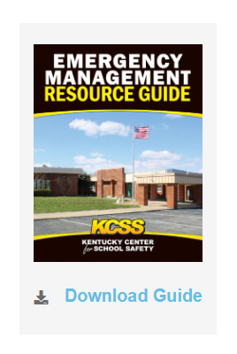
Advanced Planning

Slide 3
Reunification
Considerations
Plan
Document the Plan
Practice the Plan
Revise the Plan
Practice the Plan
**RELATIONSHIPS*RELATIONSHIPS*RELATIONSHIPS*

Slide 4
Reunification
Considerations
Once we determine the most appropriate Family Reunification Site:
Secure the Site (MOA)
Evacuate to the Site (Hwy. Dept/How to Transport)
Notify Parents of location
Send It/OneCall
Text/Email
Radio
Television
Website
Social Media

Slide 5
Reunification
Considerations
4. Reunification Set Up (Flow)
Determine Roles and Responsibilities (Supplies) a. Greeting Area, Check-in Area, Staging Area, etc.
b. Security at Site
COMING SOON KCSS Website:
*Family Reunification Plan Guide/Template *Sample Reunification Forms *Sample Reunification Map (Layout) *Sample Parent EM Information Guide

Slide 6
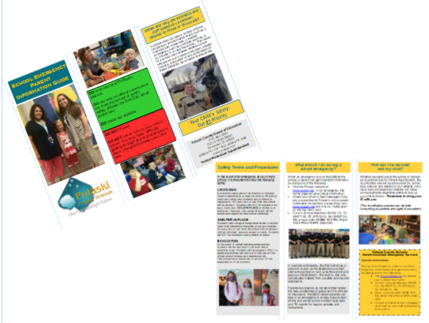
Sample Parent Guide

Slide 7
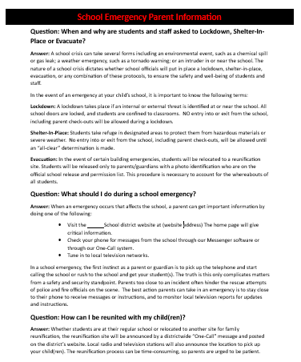
Sample Parent Guide

Slide 9
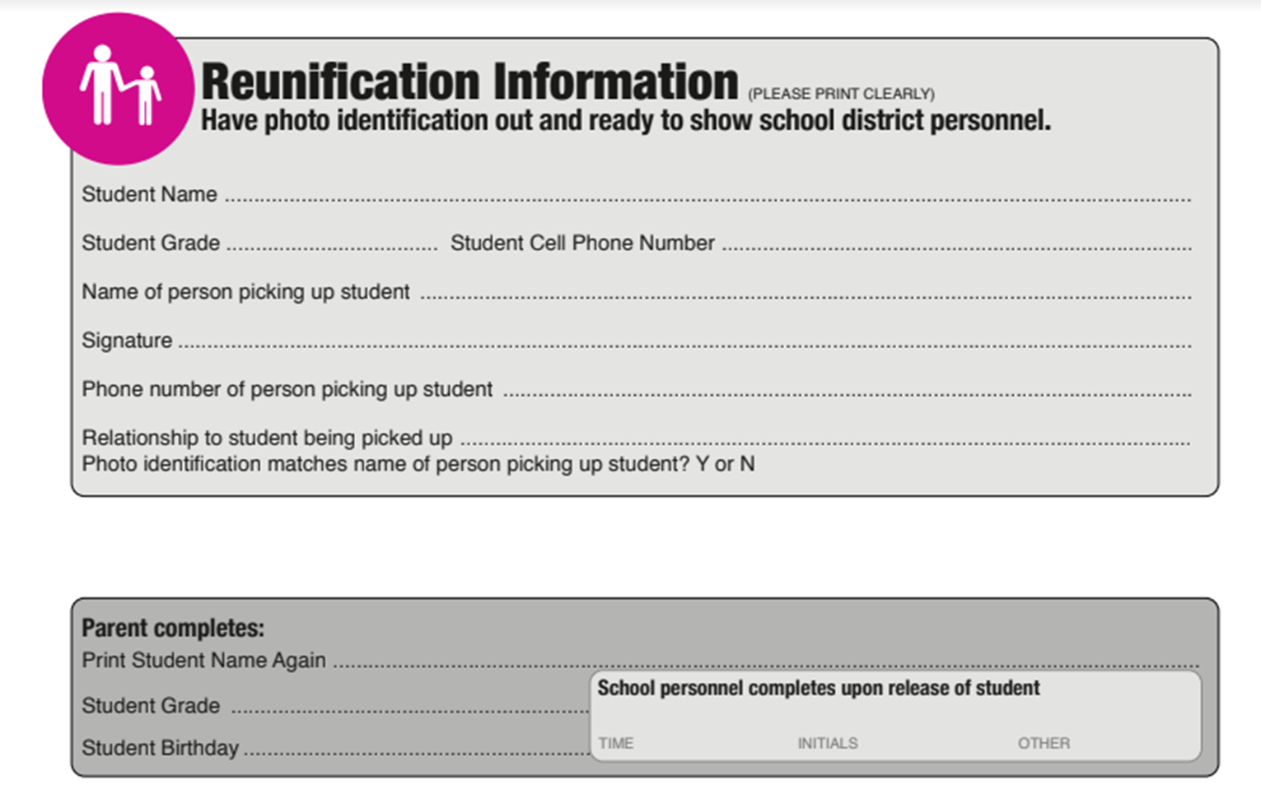

Slide 10
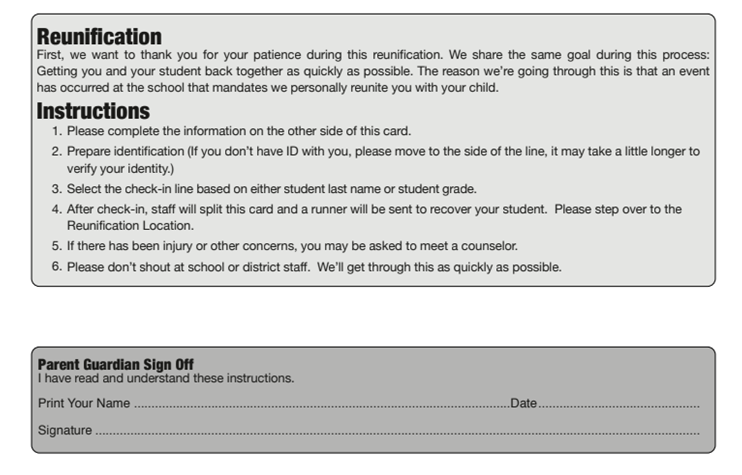

Slide 11
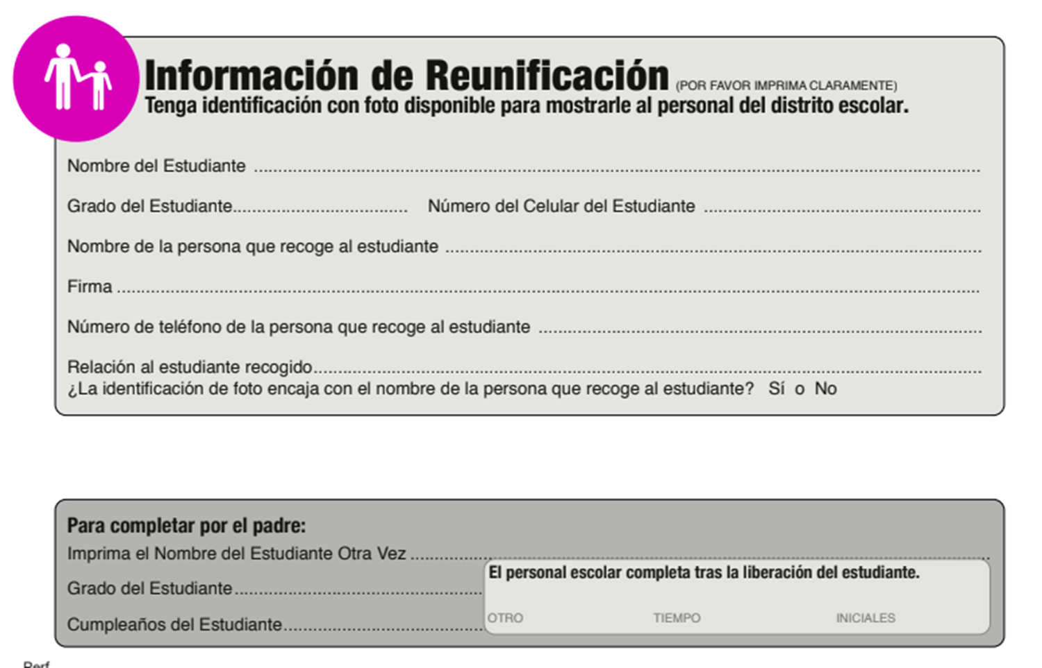

Slide 12
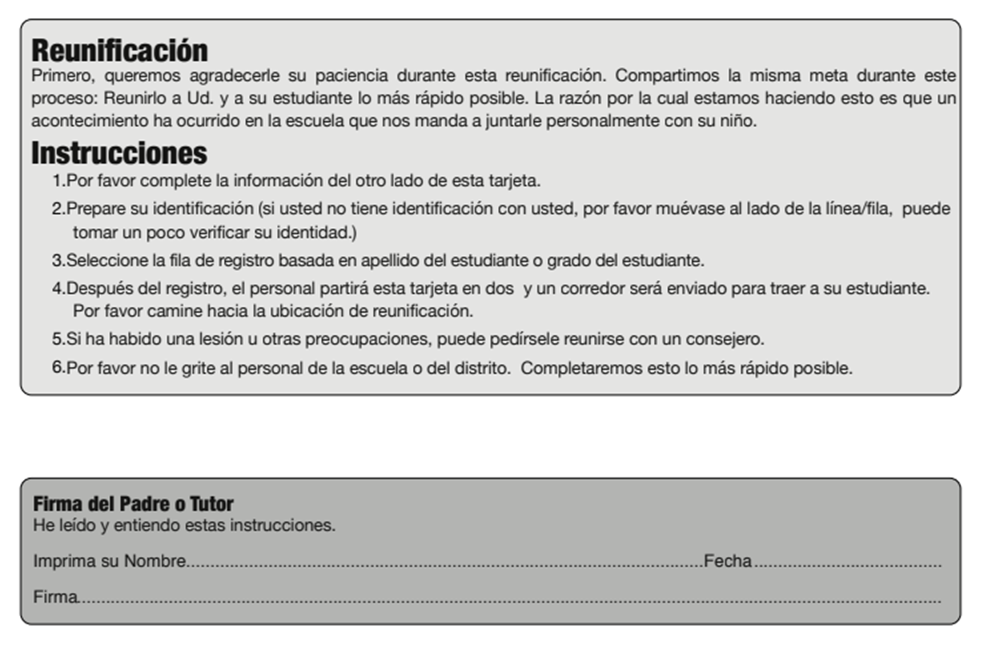

Slide 13
Response After Tragedy

Slide 14
Considerations
How will you provide transparency to stakeholders?
When can you return to school?
What mental health services will you provide?
Students
Staff
Tier 1, 2, and 3
How will people access the services?
How will you track services?
What is expected in the classroom?
Academic
Behavior
Social Emotional
What is expected with Extra Curriculars?
Are you canceling?
When will you participate?
Will you host events?
What will be provided during breaks?
Short Term Breaks?
Summer Break?

