Slide 1
What is Sexting?

Slide 2
Sexting…Define
Sexting is the exchange of sexually suggestive messages or images between minors via cell phone. For example, a girl might take an “inappropriate” picture of herself and send it to her boyfriend. Sometimes teens share the photographs voluntarily, but at other times teens may be coerced into taking or sending the photographs. Once the photos are sent, some kids use them to bully, harass, intimidate, or embarrass victims online or via mobile devices.

Slide 3
Why?
For example, a girl might take an “inappropriate” picture of herself and send it to her boyfriend. Her boyfriend may forward the picture to one or two friends, who then decide to forward the picture to others.
In this way, the girl’s picture could travel all over the Web, amassing countless viewers in a very short period of time. Sexting is the exchange of sexually suggestive messages or images between minors via cell phone or tablet.

Slide 4
Why???
Some teens have been coerced into sexting when a boyfriend or girlfriend makes it a requirement for continuing their relationship. Others have been blackmailed into sharing these photos by threats to expose previously taken pictures or losing a friendship.

Slide 5
Please note that sexting does not include situations in which young people are coerced or blackmailed into sending sexually explicit images of themselves to adults. These adults are predators and the incident should be reported to law enforcement immediately.

Slide 6
Now, Apps to Hide It
It doesn’t matter how clever the concealer of inappropriate pictures and videos is…
Sexting and having that type of material on your mobile device has harsh consequences…

Slide 7
Think about the Consequences…
1.
Of taking, sending, or forwarding a sexual picture of someone underage, even if it’s of you.
You could
get kicked-off sports teams,
get kicked-off cheering squads,
face humiliation,
lose educational privileges
and even get in trouble with the law.

Slide 8
Never Take…
2.
Pictures of yourself that you wouldn’t want everyone to see
Classmates
Family
Teachers
Employers
Think ahead
College Recruiters
Future Employers
Future Spouses and their Families
Your Children
Don’t let anyone pressure you into it!

Slide 9
Think before you send...
3.
Remember you cannot control who will see that picture or read that message once it hits the internet.
You cannot take it back.
What you send to a girlfriend or boyfriend can be forwarded to their friends, acquaintances, online chat buddies, etc…
Out of spite your image can travel to people you do not want it to reach.
It could change a life forever

Slide 10
Emotional Scars
Then there's the emotional (and reputation) damage that can come from having intimate photos of yourself go to someone you might've thought was a friend or potential friend who forwards them on in what amounts to a violation of your trust.
That can be really hurtful, obviously. And as you know, digital photos are too easy to copy and paste onto the Web, where they can be archived and searchable pretty much forever.

Slide 11
Only Open from Friends but Report if…
4.
Do not open any message from anyone you do not know
Report any inappropriate picture you receive on your cell phone to an adult you trust
Do not delete the message, take the phone to the trusted adult
Involve your teachers, parents, counselors, and principals immediately.

Slide 12
A Look at the LAW
It's illegal. For maximum safety and peace of mind, do not share inappropriate or sexually suggestive photos of yourself or anyone else.
There have even been cases of teens being charged with producing and distributing child pornography.
The owner of a device with inappropriate photos of anyone under 18 stored on it could be charged with possession.
If they go to someone in another state (which can happen really easily) it could lead to federal felony charges.

Slide 13
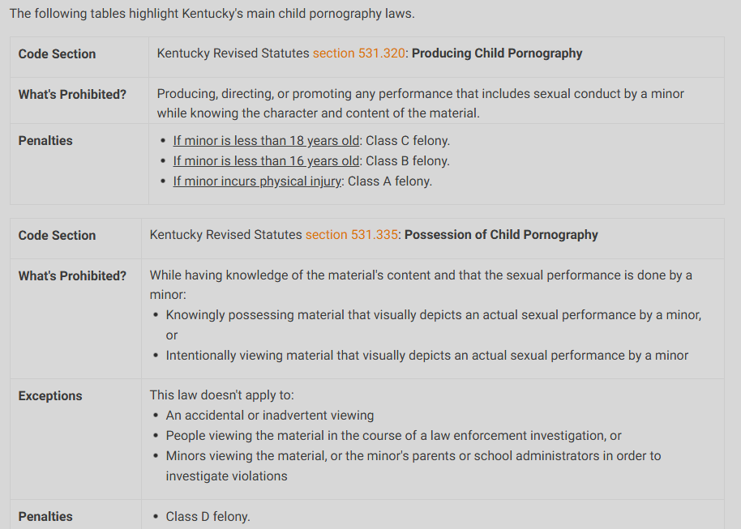
KY Pornography Laws

Slide 14
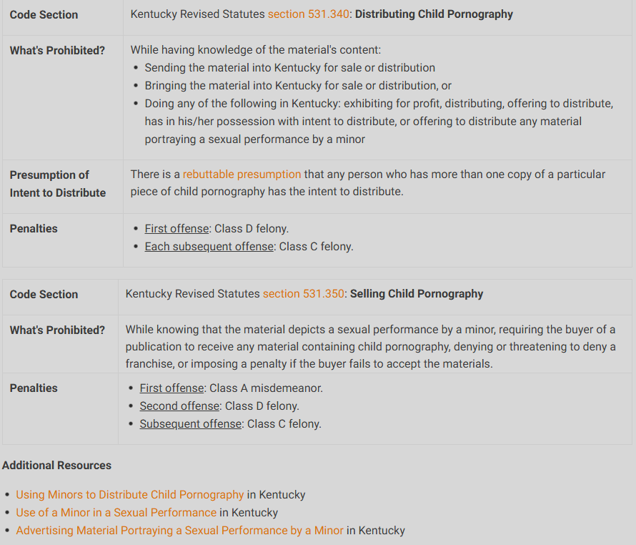
KY Pornography Laws

Slide 15
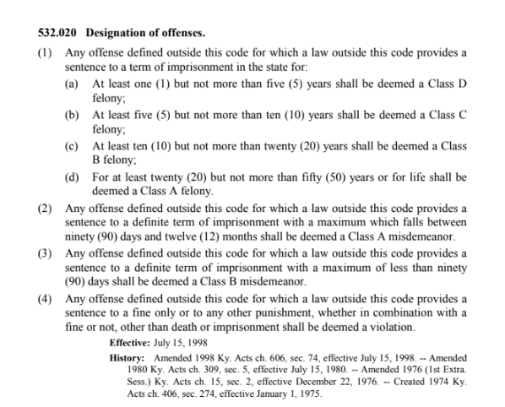

Slide 16
If You…
5.
Forward a sexual picture of someone underage (under 18) you are as responsible for this image as the original sender.
IT’S ILLEGAL
You can face…
Pornography charges
Go to jail
Register as a Sex Offender

Slide 17
Kentucky Center for School Safety Eastern Kentucky University 111 Stratton Building 521 Lancaster Avenue Richmond, Kentucky 40475 Toll Free (877) 805-4277
www.kycss.org

