Slide 1
What Exactly Is Sexting?

Slide 2
What Exactly Is Sexting?
“Sexting” is a term used to describe the sharing of intimate images or video with another person.
The content can range from sexually driven texts and partial or full nude photos to sexual videos or pornography.
Very often, sexting occurs between couples or people who are dating, but it can also happen between friends or groups.
Sexting can happen via a whole range of devices, technologies, and online spaces.
Most commonly, sexting occurs through text, private message on social networks, or apps.

Slide 3
8 Things To Know
About Sexting
Link to Video

Slide 4
Sexting is a growing challenge.
Survey result indicate that
20% of adolescents ages 13–19 have sent or posted nude or semi-nude pictures of themselves
71% of adolescent females and 67% of adolescent males who have sexted sent the content to a boyfriend or girlfriend
38% of adolescent females and 39% of adolescent males report having seen messages originally intended for someone else
https://www.nasponline.org/Documents/Resources%20and%20Publications/Handouts/Families%20and%20Educators/May_13_Sexting.pdf

Slide 5
Amanda’s Story ... Amanda Todd committed suicide at the age of 15 at her home in British Columbia, Canada. Before she took her life, Amanda posted a video on YouTube in which she used a series of flash cards to share her experience of being blackmailed into exposing her bare top via webcam and being bullied and physically assaulted. The video went viral after her death, resulting in international media attention.
Amanda Michelle Todd
(November 27, 1996 - October 10, 2012)
My daughter, Amanda Michelle Todd, took her life at the age of 15. It all started with a topless photo. She didn’t know the person at the other end of her computer was taking a picture. She didn’t know that he was showing it to other men. Then she started to get blackmailed into showing more of herself via her webcam. And if she didn’t, then her image would be sent throughout the Internet.
What Amanda didn’t do was tell an adult that this was happening to her. She kept it to herself. This image and what happened thereafter was the start to the emotional breakdown of Amanda.
Sincerely, Carol Todd (Amanda’s mom)
For more information on Amanda’s story, please visit: http://amandatoddlegacy.org

Slide 6
Amanda Todd

Slide 7
Amanda Todd

Slide 8
Amanda Todd

Slide 9
Amanda Todd

Slide 10
Amanda Todd

Slide 11
Was asked show something risky…

Slide 12
Amanda Todd

Slide 13
Amanda Todd

Slide 14
4 a.m. a Knock at the Door of My House…

Slide 15
Amanda Todd

Slide 16
Then
Moved
Got into Drugs and Alcohol
A year later the guy set up a Facebook Page
He used my “Risky” picture for his profile picture

Slide 17
Amanda Todd

Slide 18
Amanda Todd

Slide 19
Amanda Todd

Slide 20
Although Amanda’s story is an extreme case of what can go wrong, it does highlight the pressures many people can feel when they want to gain another person’s trust or fit in.
It also serves as an illustration of the aftermath that can occur when an image of oneself gets onto the Internet.

Slide 21
Why?
Commonsensemedia.org

Slide 22
Think about the Consequences…
1.
Of taking, sending, or forwarding a sexual picture of someone underage, even if it’s of you.
You could
get kicked-off sports teams,
get kicked-off cheering squads,
face humiliation,
lose educational privileges
and even get in trouble with the law.

Slide 23
Never Take…
2.
Pictures of yourself that you wouldn’t want everyone to see
Classmates
Family
Teachers
Employers
Think ahead
College Recruiters
Future Employers
Future Spouses and their Families
Your Children
Don’t let anyone pressure you into it!

Slide 24
Think before you send...
3.
Remember you cannot control who will see that picture or read that message once it hits the internet.
You cannot take it back.
What you send to a girlfriend or boyfriend can be forwarded to their friends, acquaintances, online chat buddies, etc…
Out of spite your image can travel to people you do not want it to reach.
It could change a life forever

Slide 25
Only Open from Friends but Report if…
4.
Do not open any message from anyone you do not know
Report any inappropriate picture you receive on your cell phone to an adult you trust
Do not delete the message, take the phone to the trusted adult
Involve your teachers, parents, counselors, and principals immediately.

Slide 26
If You…
5.
Forward a sexual picture of someone underage (under 18) you are as responsible for this image as the original sender.
IT’S ILLEGAL
You can face…
Pornography charges
Go to jail
Register as a Sex Offender

Slide 27
Sexting Laws in Kentucky

Slide 28
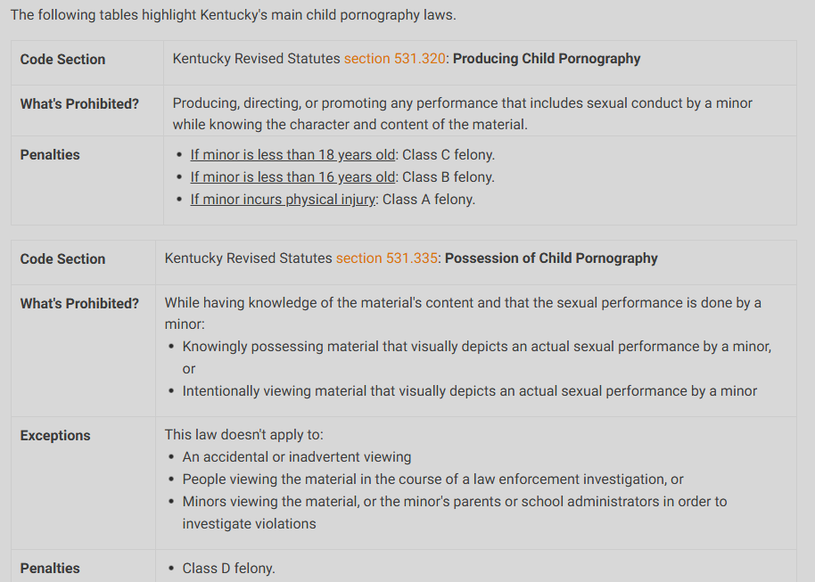
KY Pornography Laws
It’s exciting

Slide 29
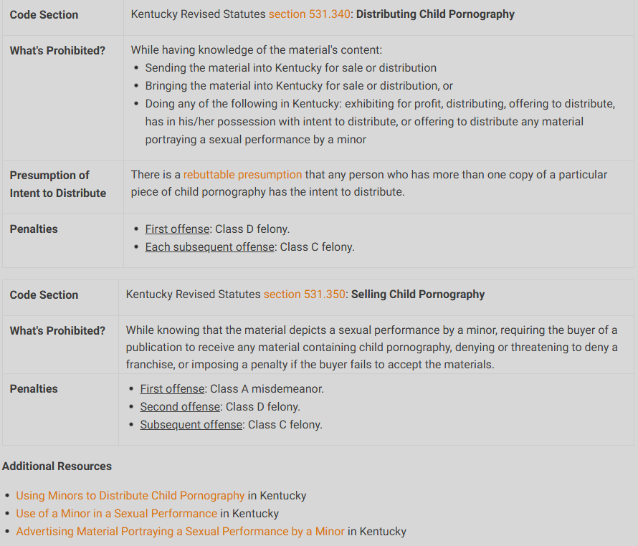
KY Pornography Laws
It’s exciting

Slide 30
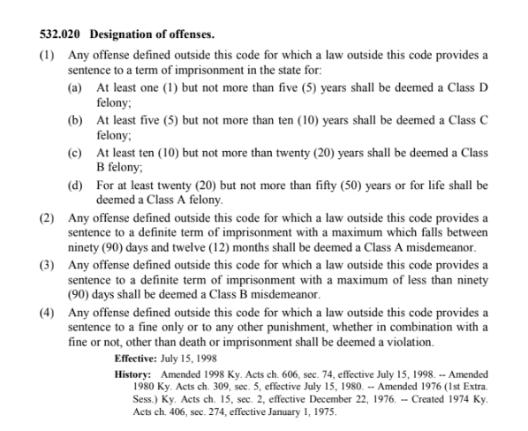

Slide 31
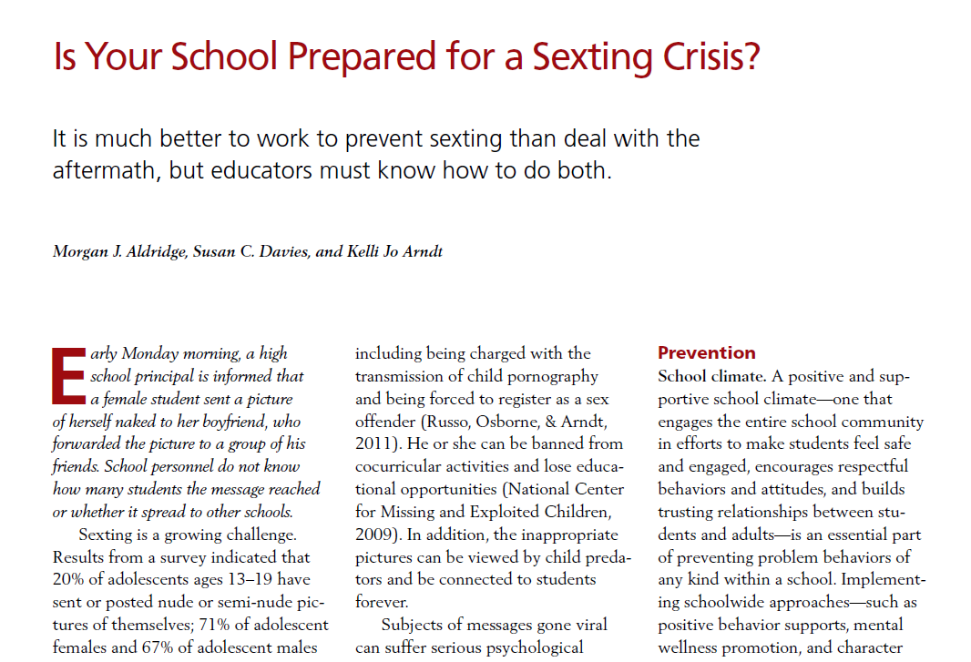
https://www.nasponline.org/Documents/Resources%20and%20Publications/Handouts/Families%20and%20Educators/May_13_Sexting.pdf

Slide 32
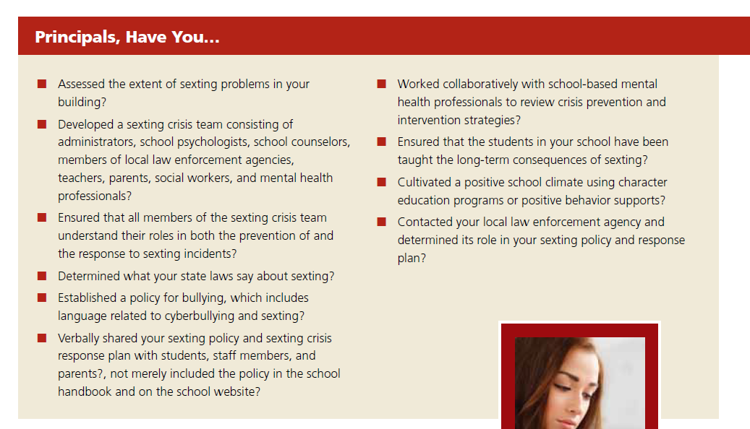
https://www.nasponline.org/Documents/Resources%20and%20Publications/Handouts/Families%20and%20Educators/May_13_Sexting.pdf

Slide 33
So as Administers/Educators, what do we do now….
Educate Students, Staff and Parents
Annually (REMS)
All people who work with students
Monitor online activity on school devices
Overview of a free monitoring program (BARK)
Review and Revise (if necessary) policies and procedures
Annually
Samples policies are provided in resource
material (REMS)
-Sample procedures (Protocol)

Slide 34
Mentoring Program for all School Tech Devices
https://www.youtube.com/watch?v=LwZS9DElH0c

Slide 35
https://rems.ed.gov/docs/ASMTrainingGuide.pdf

Slide 36
Webinar
https://rems.ed.gov/AddressingAdultSexualMisconductWebinars.aspx#

Slide 37
What Does a Responsible Staff Educational Program Look Like?
Educate all groups
Administrators, Teachers, Teacher Aides, Substitutes, Bus Drivers, Coaches, Cafeteria, Janitorial staff…
All groups who interact with students in your school or at other school functions (before/after school programs, sports events, field trips, etc...)
Common Sense pointer for avoiding false allegations…REMS pg. 20

Slide 38
What Does a Responsible Staff Educational Program Look Like?
Suggestions on frequency
Annual for all
As new hires are added, they must be trained
Possible Agenda (checklist on REMS pg 30)
Introduction from your administrator
Use REMS Webinar (1 hour Duration)
Cover your district policies and reporting tools
Create a 10-15 questionnaire/survey (paper or Chromebook)
Keep surveys signed and dated as documentation
Consider holding a parent training

Slide 39
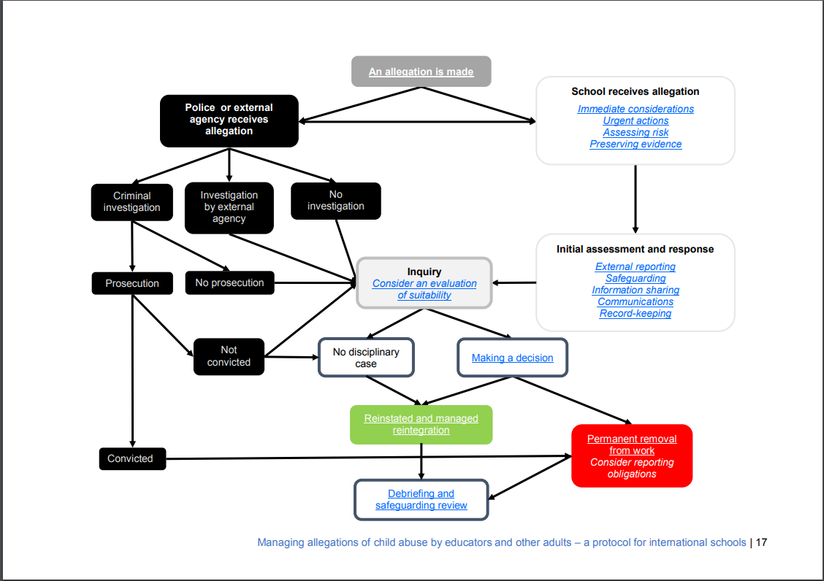
Managing Allegations of Child Abuse by Educators: A Protocol
https://www.cois.org/uploaded/Documentation/About_CIS/Child_Protection/Protocol_-_Managing_Allegations_of_Child_Abuse_by_Educators_and_other_Adults.pdf

Slide 40
Kentucky Center for School Safety Eastern Kentucky University 111 Stratton Building 521 Lancaster Avenue Richmond, Kentucky 40475 Toll Free (877) 805-4277
www.kycss.org

